Slide 1
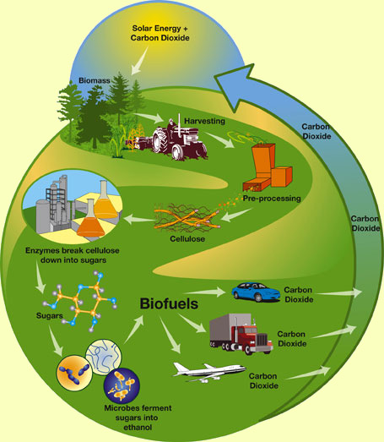
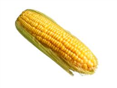
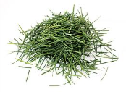
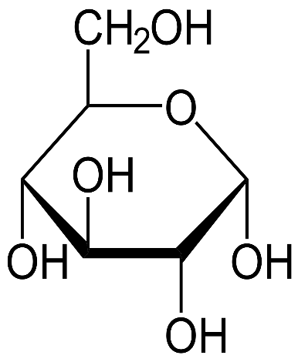
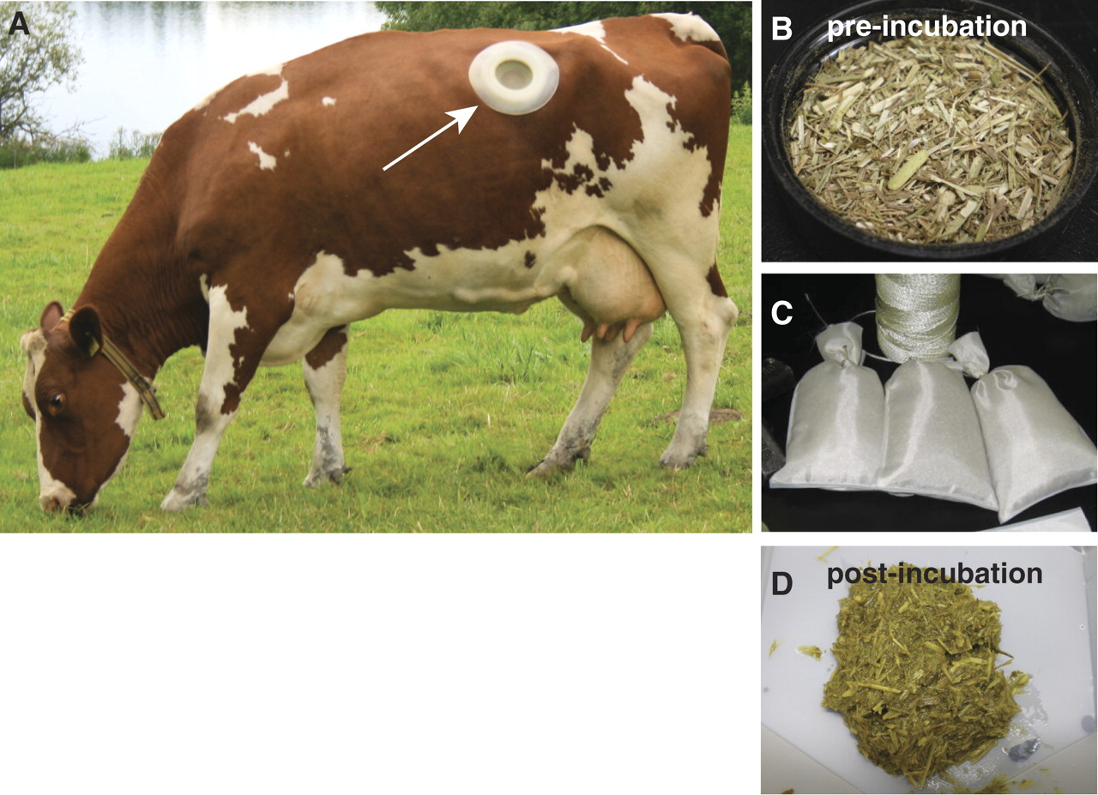
CUREs Lab Students conducting relevant research report significant gains in analyzing data , problem solving, and understanding.
Non-Cognitive Predictors of Student Success: A Predictive Validity Comparison Between Domestic and International Students
Better Labs Through CUREs: Course Based Undergraduate Research Experiences
Assessment
Students reported a higher sense of personal achievement, and confidence in their ability to contribute to solving a real world problem.
PRESENTER:
Dr. Jenny Cappuccio, HSU
Dr. Matthew Escobar, CSUSM
BACKGROUND:
Undergraduate research is a high-impact educational practice (Koh 2008 AAC&U).
The Problem
Only a limited number of student are able to access in depth research experiences due to limited faculty time and funding.
Approach
Incorporate course based undergraduate research experiences (CUREs) into course design
CHEM 434L Biochemistry I (HSU)
BIOT 355 - Molecular Biotechnology (CSUSM)
Relevant Research! → Biofuels
Students investigate potential cellulase enzymes
for their ability to break down
cellulose for biofuels.
Partner with DOE
Joint Genome Institute and
UC Davis
Research Goal
Identify novel cellulase enzymes
Develop better biofuel production methods
Ultimately reduce carbon dioxide emissions
Educational Goal
More students can access high-impact research practices to a broader array of diverse students and can serve as an equity based practice.
56% (CSUSM) - 61% (HSU) students report no prior research.
METHODS
Hess et al 2011 Bioprospecting for Cellulases (JGI partners)
Metagenomic analysis
of cow rumen
Switchgrass bovine
microbiome
Identified 27,755
Putative carbohydrate
active genes
Only 90 analyzed (0.3%)
57% enzymatically active
Research Results
Some cellulase activity observed …Currently under analysis
Starch
Cellulose
Alpha amylase
Cellulase
Glucose
Microbial fermentation
Ethanol
Dr. Jenny Cappuccio, HSU Chemistry
Dr. Matthew Escobar, CSU San Marcos
BIOT 355 CSUSM Complete Semester 2019 CHEM 434L - 4 weeks partial semester 2020 (JGI clones) CHEM 435L
Isolate DNA from cow rumen microbes
Amplify the gene isolated DNA by PCR
Insert the gene sequence into expression vector and transform
Top10 E. coli
Colony PCR to identify recombinant vectors
Isolate plasmid, sequence to verify cellulase gene insert
Transform
BL21 E. coli
Grow culture
Activate protein production with IPTG
Isolate protein
Analyze concentration
purify the His-tagged proteins
CMC Cellulase Plate Assay
Visualize Protein SDS-PAGE
Further
Research
Scaffold
Student Design
Notes:
Notes:
In Powerpoint, click View > Guides
Keep text within gutter guides.
Author list: Don’t split names onto two lines (e.g., “Jimmy [break] Smith”). If that happens, use a new line, unless you need the space. Bold the first names of anybody who’s presenting in person.
Intro/methods/result: Do not drop below font size 28, but if you have extra space, jack up the font size until the space is full.
Do not use color in the sidebars except in graphs/figures. It’ll pull attention from the center and slow interpretation for passersby.

